Slide 2

?

Slide 3
What can one person do?
https://www.youtube.com/watch?v=aILYbUDGDks&list=RDRBw08GbrR-g&index=2

Slide 4
TASH SULTANA
She’s a 22 year old Australian solo artist
She played in Dublin June 2017
Why are we interested?
Is it -
Her style
Her technical ability
The message of her lyrics
Her ability to play many instruments
What is her appeal?
Would she appeal to everybody?

Slide 5
Have a discussion about Tash

Slide 6

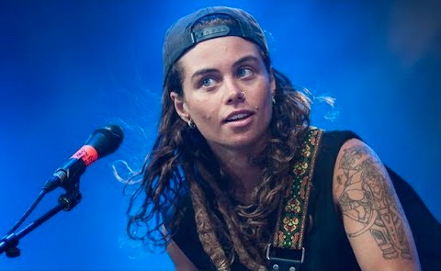
Who could charge more for entry to their concert?
Why?

Slide 7
…and now for the Marketing class

Slide 8

Look at the brands. Choose a few…
Discuss who the consumer of these brands may be?
Are the customers all the same…What age are they?
Are all of the brands appealing to the same gender?
What do you think their preferences might be?
What else would be useful to know?

Slide 9
Consumer Buying Behaviour

Slide 10
Know Your Customer

Slide 11
Why?

Slide 12
Why is it important to know your customer?
Businesses want to attract potential customers
Better customer knowledge will help attract more of them
It is helpful to understand what influences peoples choices
Knowing what customers want will help grow sales

Slide 13
How to know your customer better
Build up a picture of your customers by finding out more about them.
For example, in a particular location, you may want to find out about their:
Age group – how many potential customers in each different age group
Gender – say…how many of each across different age ranges
Income level…age and gender together with income level is useful information
Education and Occupation…adds to building a more complete understanding
Sporting and Social interests…and this list can continue indefinitely

Slide 14
Getting to know your customer better…will:
Help you to design better product and services
Plan more efficient ways to deliver products and services
Help in setting prices
Plan the most effective way to stay in touch with customers
Help to give better customer experiences
Ultimately, it will help to grow more business

Slide 15
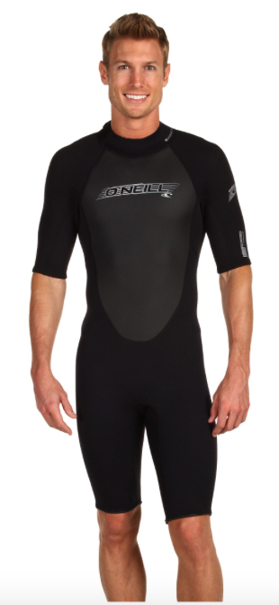
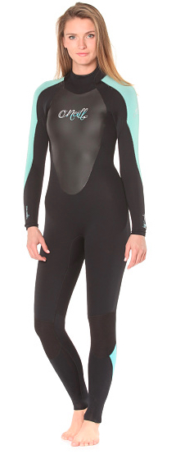
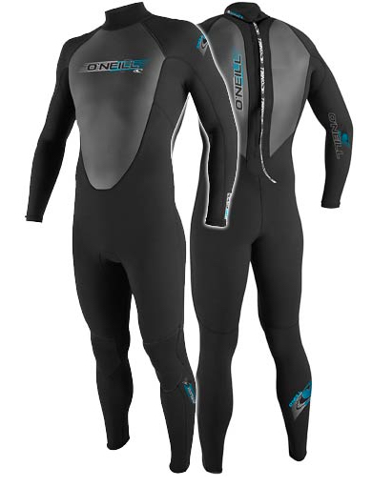
Who is likely to be the customer for this product?

Slide 16
What do we know?
Discuss who the customer for O’Neill wet suits might be?
Discuss their lifestyle, their interests and their preferences.
Why would they buy wet suit?
Why would they buy and O’Neill wet suit?

Slide 17
Wouldn’t is be great to find out what it is that influences people’s buying choices?
Social influences
Do you identify with Tash Sultana or a philharmonic orchestra?
Does your family influence your outlook? Positively or negatively?
What is your role – are you buying for yourself or someone else…if so, who?
The ‘who’ will influence your behaviour in that role…in that moment are you –
  Son or daughter, boyfriend / girlfriend
  Husband / wife
  Parent
  Relative / friend / acquaintance
On any given day, a person can fill more than one of these roles and that perspective can influence our decisions

Slide 18
Other Influences on people’s buying choices?
Personal influences
Age / at what stage of life are you? – this affects your preferences
Occupation & economic circumstances – high or low disposable income?
Lifestyle & personality – like & dislikes?
Psychological influences
What motivates you? The basic needs of life or an expression of your personality?
Learning – preferences change as you learn and experience more
What are your beliefs and attitudes – Tash Sultana may well not be for you!

Slide 19
What is the process involved in choice?
Recognising a need
Buy more bread or sugar – because you’ve run out?
Information Search & Consider the alternatives
Buying a new computer – what do you need / what does it have
What other computers are there at the same price, speed, battery life, etc.
Look at ‘comparison website’
Read others opinions, such as – “Trusted Advisor”
Purchase decision and after-purchase behaviour
Use the product or service and post/opinion a review online
Post a blog about your buying experience, or about the product or service
Tell friends and family

Slide 20
Summary
We have considered Consumer Buying Behaviour
With these various inquiries you are accumulating information.
This feeds your Marketing Information System and helps with planning and decisions
Markets must understood before marketing strategies can be developed

Slide 21
Marketing Task – Consumer Buying Behaviour
Choose a product / service –
Outline what information about customers you would find useful in planning.
Think about the following factors in your planning:
Price
Think about what is involved in setting the price
What effect it may have on sales to customers.
Also, what effect it may have on the company
Product
Impact on product design – mass market / specific customers

Slide 22
Marketing Task – Consumer Buying Behaviour
Think about the following factors in your planning:
Place
Delivery method or location, e.g.
Mobile Apps sell online and are delivered online
Amazon sells online but delivers offline
Department stores generally sell and supply products offline
Promotion
What methods of promotion will be most appropriate
Traditional offline advertising
Online targeted advertising
    In-store sampling
    Public exhibition, etc.

